Slide 1

BeaconApp
USER MANUAL

Slide 2
Table of content
Overview
Using the Application
Troubleshooting
2
USER MANUAL

Slide 3

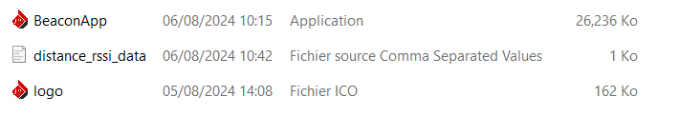
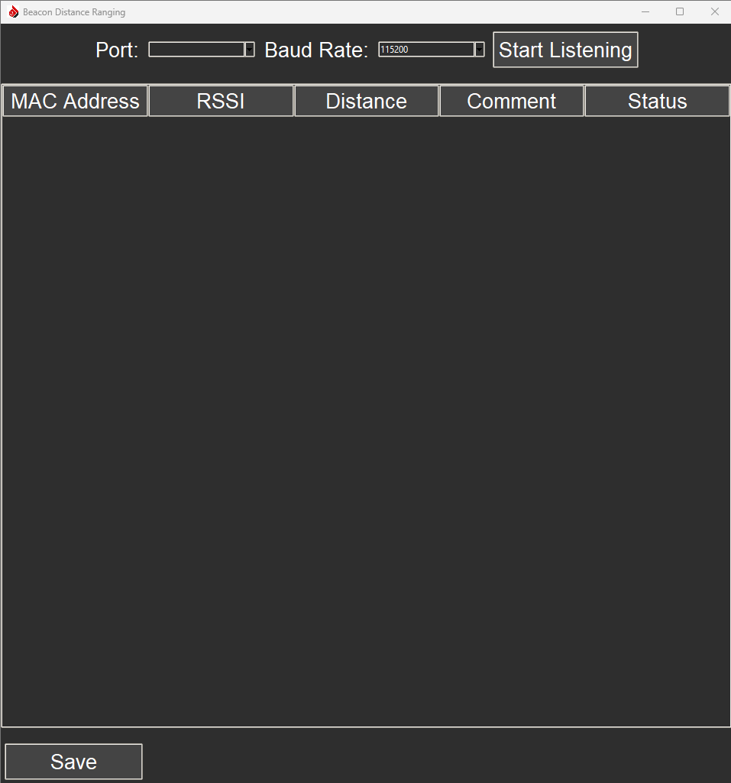
I- Overview
This application is designed to read data from beacons via serial communication, parse the data, and display it in a UI. It tracks the Received Signal Strength Indicator (RSSI) values of beacons, updates the displayed information in real-time, and saves the data to a CSV file. Users can also edit distance and comments associated with each beacon.
User Interface Overview
Open the application « BeaconApp.exe »
Baud Rate Selection:
Dropdown to select the baud rate
Port Selection: Dropdown to select the USB serial port.
Start Listening Button: Button to initiate reading from the selected serial port.
Table:
Displays beacon MAC addresses, RSSI values, distances, comments, and status.
Save Button:
Saves the current table data to a CSV file.
3
Figure 1: user interface
USER MANUAL

Slide 4
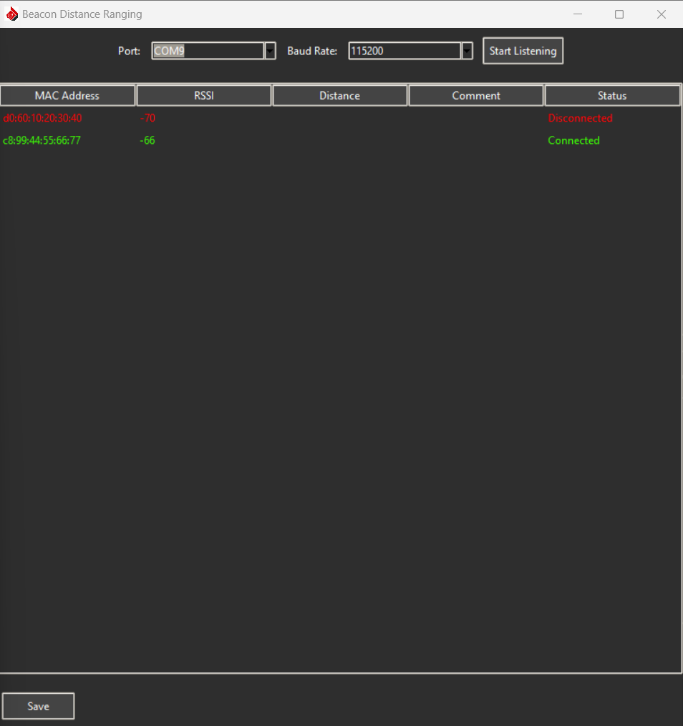
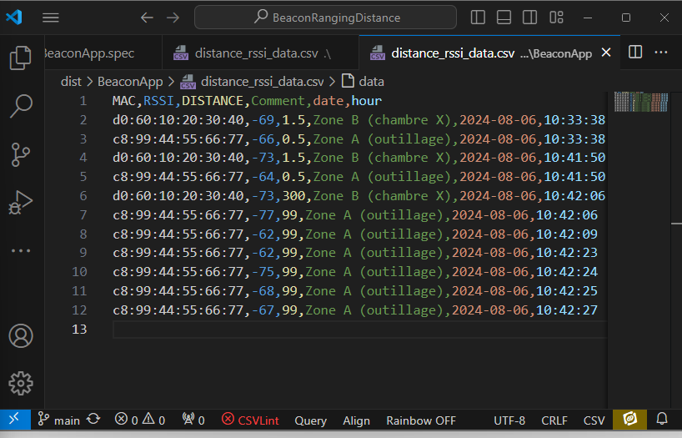
II- Using the Application
1) Select USB Port, and baud rate 115200, then click on Start listening
2) In the beacons table, you will notice the detected Beacons data
3) To add distance, double click in the cell and write distance in m, then hit “ENTER” to add data to the table.
Same way for the “comment”
4) Click the "Save" button to save the current table data to a CSV file named “distance_rssi_data.csv”
Figure 2: user interface
N.B: Beacon not connected means it didn’t send data for more than 10 seconds
Figure 3: CSV saved data
4
USER MANUAL

Slide 5
III- Troubleshooting
Failed to Open Serial Port: Ensure the selected port is correct and not being used by another application.
No Data Received: Check the USB port connection and ensure the beacon is powered and within range.
5
USER MANUAL

